Slide 1
Analyzing a Triangle Problem on Finite 3-Dimensional Lattices
Javier Khaaliq, Nathaniel Johnson
Advisor: Dr. Robert Niichel
Fairmont State University

Slide 2
Background
Problem posed by Lewis Carroll in 1893:
“Choosing three random points on the infinite plane, what is the probability the triangle formed is obtuse?”
Our adaptation:
“Choosing three random points on a n-by-n grid, what is the probability the triangle formed is obtuse?”
Continuation of previous work
First step toward generalizing work in 2D into 3D
Creating the foundation for future researchers to assist developing theorems.

Slide 3
Foundation
Holding two coordinates constant and allowing the third to approach infinity, we investigate the allowed triangles and non-triangles that will fit within the created lattice grid
We use the following classifications: non-triangle (three or more collinear points), right triangle, acute triangle, obtuse triangle
Goal: Find a limiting probability for the total number of triangles and non-triangles and the individual limiting probabilities for each classification within the grid

Slide 4
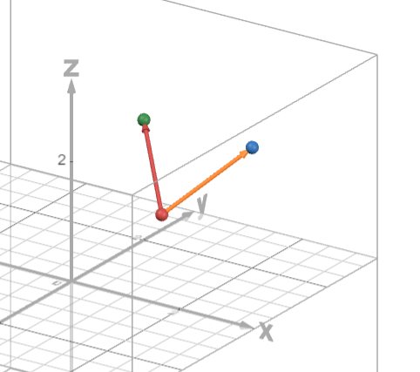
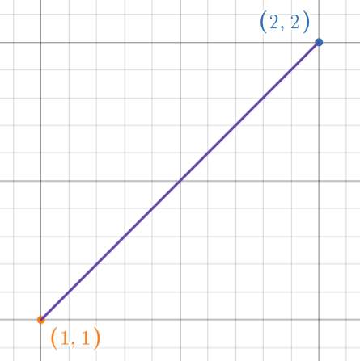

Fundamentals of Vectors
Vectors:
Mathematical object prevalent in physics and linear algebra
Graphically represented as an arrow between point
$v=<a,b>$or $v=<a,b,c>$
Magnitude measures the length between the head of the vector and its tail
$\left|\left|v\right|\right|=\sqrt{a^{2}+b^{2}+c^{2}}$
Dot product:
$v_{1}⋅v_{2}=a_{1}a_{2}+b_{1}b_{2}+c_{1}c_{2}$
Operator for vectors
Related to the angle between the two vectors
Results in a number, not another vector
Figure 1: Two 3D vectors
Figure 2: A 2D vector

Slide 5
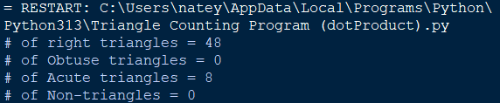
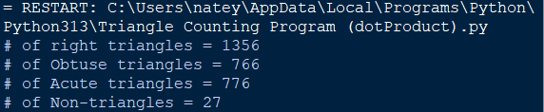
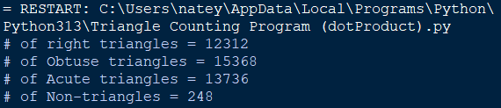

Computing Angles
Program Methodology:
Generate a list with all possible point combinations
Iterate through the point list to generate all possible vectors
Classify and record triangle type using vector information
Triangle Classification:
Law of Cosines
Use the side lengths to find all angles
$\cos{θ= \frac{c^{2}{−a}^{2}−b^{2}}{−2ab}}$
Dot Product
Use the relation to cosine to find all angles
$\cos{θ}=\frac{u ⋅ v}{\left\|u\right\|∗\left\|v\right\|}$
Program Output for a 2x2x2 Lattice
Program Output for a 3x3x3 Lattice
Program Output for a 4x4x4 Lattice

Slide 6
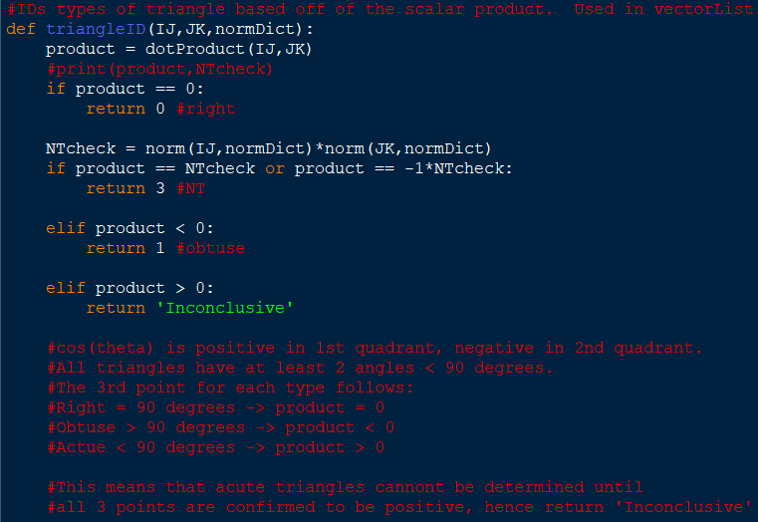
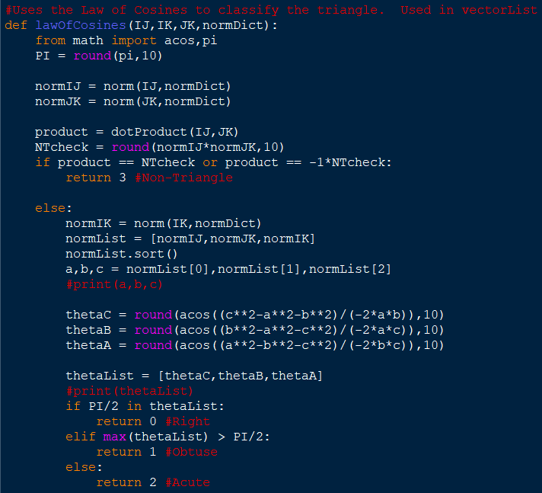
Triangle Classifications
Dot Product Classification
Law of Cosines Classification

Slide 7

Visualizing the Grid
Program Methodology
GUI: Simple user interface which allows for repeated use without rerunning code
Random/Manual Mode: Allows for user input to generate a specific triangle using coordinates or generates a random triangle
Triangle Classification: Determines the type of triangle using Law of Cosines
Viewing: Shows grid, points, and allows for deeper visual analysis of a specific triangle
Program Creation:
Language: Python
Libraries: Plotly (visualization), Dash (GUI)
Formulas:
Law of Cosines:
$c^{2}<a^{2}+b^{2}$ (Acute Triangle)
$c^{2}=a^{2}+b^{2}$ (Right Triangle)
$c^{2}>a^{2}+b^{2}$ (Obtuse Triangle)
Area: $\frac{1}{2}|AB×AC|$

Slide 8
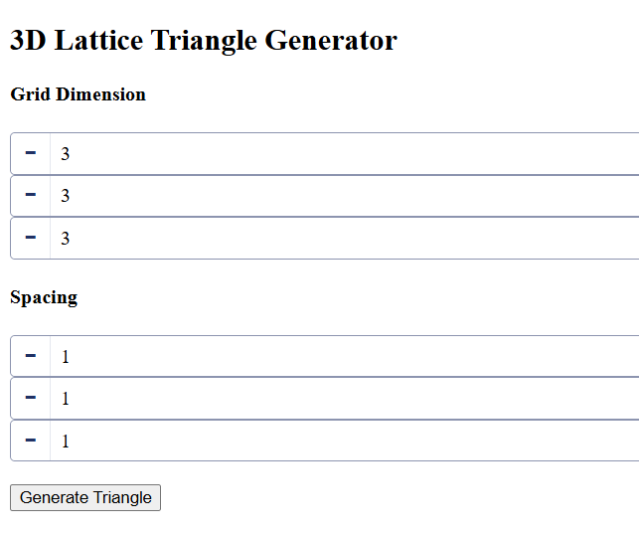
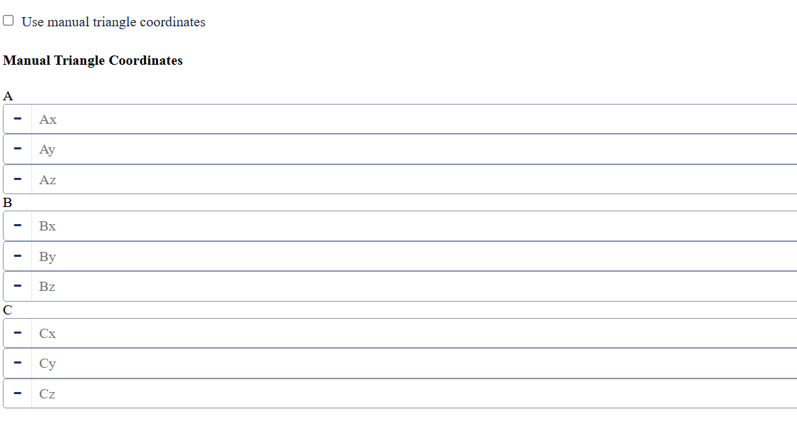
Creating the Grid

Slide 9
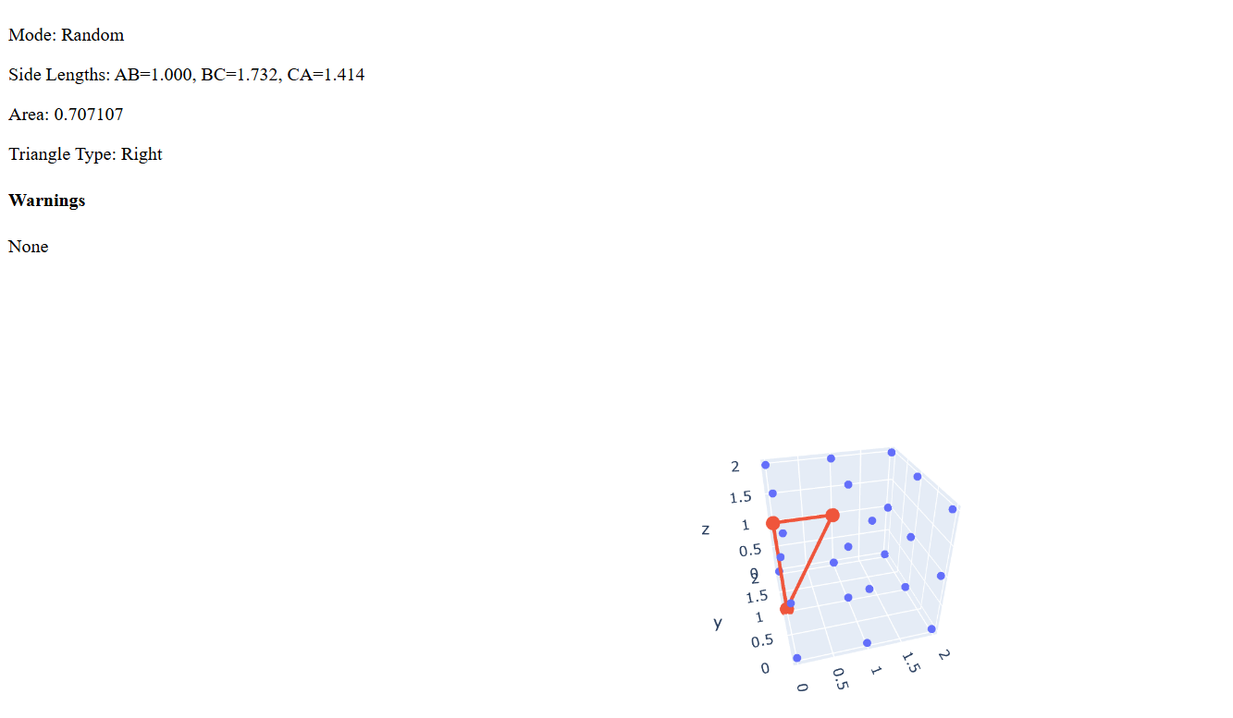
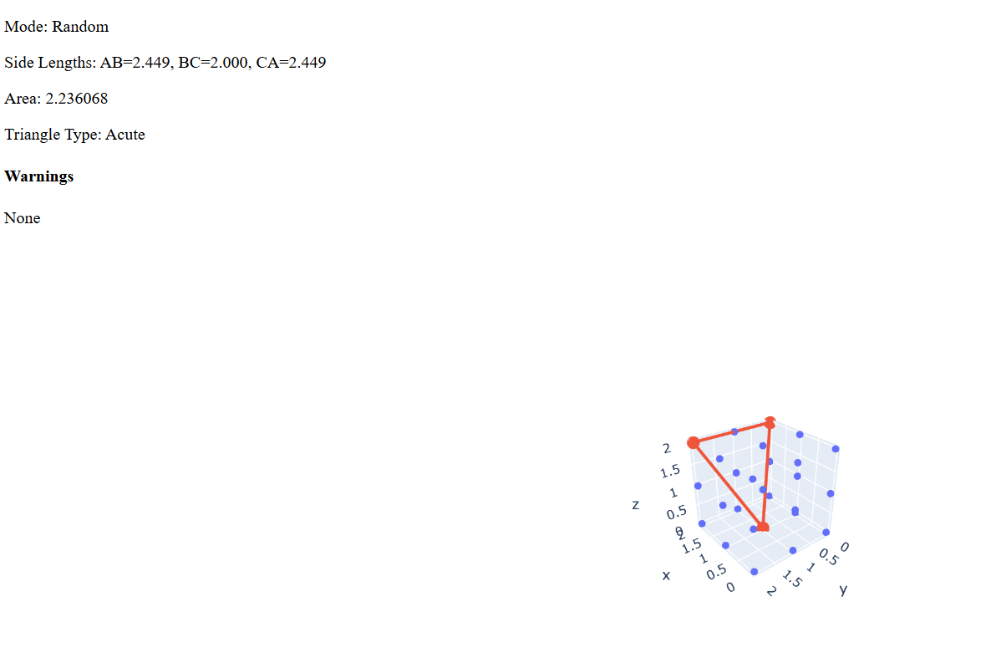
Grid Display

Slide 10
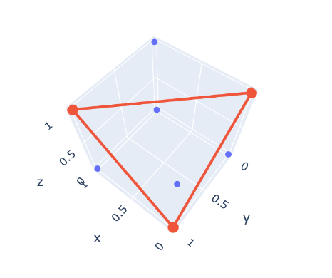
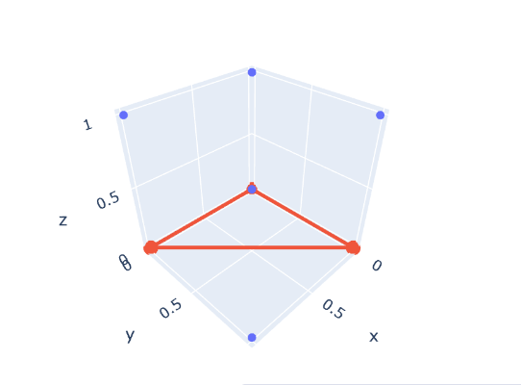

$2×2×2$ Case
In this case we’ve found the following:
Number of non-triangles: 0
Number of right triangles: 48
Number of acute triangles: 8
Number of obtuse triangles: 0

Slide 11
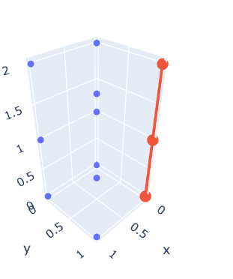
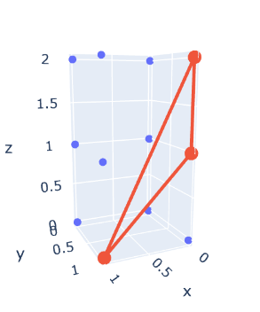
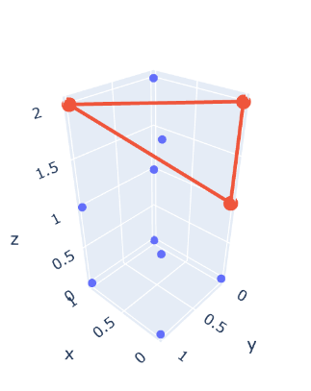
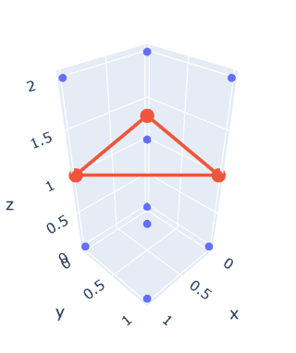


$2×2×3$ Case
In this case, we have found that:
Number of non-triangles: 4
Number of right triangles: 156
Number of acute triangles: 28
Number of obtuse triangles: 32
The number of non-triangles in the $2×2×n$ case is given by $N_{2×2×n}=4({n \atop 3})$

Slide 12
Current Hurdles
Ensuring that we are in-sync with the programs in correctly counting and identifying each potential triangle in a given grid
Ensuring programs will allow for efficient and effective analysis of higher dimension lattices

Slide 13
Acknowledgement
This research was made possible by the NASA West Virginia Space Grant Consortium, Grant #80NSSC25M7079.

